Slide 1
NoSql Database
Dr. Salahuddin

Slide 2
CAP Theorem
The CAP theorem is used to makes system designers aware of the trade-offs while designing networked shared-data systems. CAP theorem has influenced the design of many distributed data systems.
It is very important to understand the CAP theorem as It makes the basics of choosing any NoSQL database based on the requirements.

Slide 3
CAP Theorem
CAP theorem states that in networked shared-data systems or distributed systems, we can only achieve at most two out of three guarantees for a database: Consistency, Availability and Partition Tolerance.
A distributed system is a network that stores data on more than one node (physical or virtual machines) at the same time.

Slide 4
Let’s first understand C, A, and P in simple words:
Consistency: means that all clients see the same data at the same time, no matter which node they connect to in a distributed system. To achieve consistency, whenever data is written to one node, it must be instantly forwarded or replicated to all the other nodes in the system before the write is deemed successful.

Slide 5
Let’s first understand C, A, and P in simple words:
Availability: means that every non-failing node returns a response for all read and write requests in a reasonable amount of time, even if one or more nodes are down. Another way to state this — all working nodes in the distributed system return a valid response for any request, without failing or exception.

Slide 6
Let’s first understand C, A, and P in simple words:
Partition Tolerance: means that the system continues to operate despite arbitrary message loss or failure of part of the system. In other words, even if there is a network outage in the data center and some of the computers are unreachable, still the system continues to perform. Distributed systems guaranteeing partition tolerance can gracefully recover from partitions once the partition heals.

Slide 7
The CAP theorem categorizes systems into three categories:
CP (Consistent and Partition Tolerant) database: A CP database delivers consistency and partition tolerance at the expense of availability. When a partition occurs between any two nodes, the system has to shut down the non-consistent node (i.e., make it unavailable) until the partition is resolved.

Slide 8
The CAP theorem categorizes systems into three categories:
Partition refers to a communication break between nodes within a distributed system. Meaning, if a node cannot receive any messages from another node in the system, there is a partition between the two nodes. Partition could have been because of network failure, server crash, or any other reason.

Slide 9
The CAP theorem categorizes systems into three categories:
AP (Available and Partition Tolerant) database: An AP database delivers availability and partition tolerance at the expense of consistency. When a partition occurs, all nodes remain available but those at the wrong end of a partition might return an older version of data than others. When the partition is resolved, the AP databases typically resync the nodes to repair all inconsistencies in the system.

Slide 10
The CAP theorem categorizes systems into three categories:
CA (Consistent and Available) database: A CA delivers consistency and availability in the absence of any network partition. Often a single node’s DB servers are categorized as CA systems. Single node DB servers do not need to deal with partition tolerance and are thus considered CA systems.

Slide 11
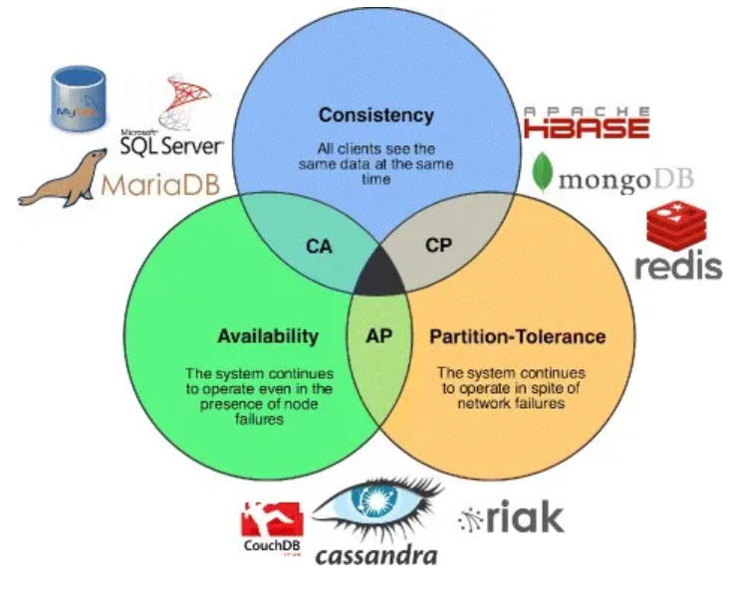
The following diagram shows the classification of different databases based on the CAP theorem.

Slide 12
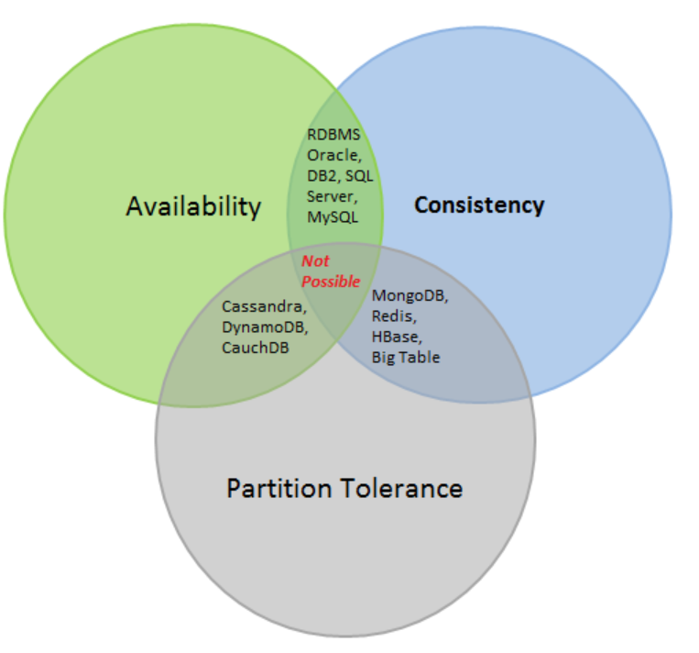
The following diagram shows the classification of different databases based on the CAP theorem.
Use Cases
Financial System : Consistent & Available​
Chat Applications : Consistent & Partition tolerant​
Cache : Redis – Consistent & partition tolerant​
Social Site (Analytics Metadata as likes, feeds, views) – Available and Partition tolerant

